Slide 1
Dijkstra’s Algorithm
Suyash Shekhar

Slide 3
Object-oriented programming is an exceptionally bad idea which could only have originated in California. Computer science is no more about computers than astronomy is about telescopes. There should be no such thing as boring mathematics. The competent programmer is fully aware of the limited size of his own skull. He therefore approaches his task with full humility, and avoids clever tricks like the plague. The use of COBOL cripples the mind; its teaching should, therefore, be regarded as a criminal offense. - Edsger Dijkstra

Slide 4
SSSP Special Cases

Slide 5
CASE 1: Tree
The graph has a unique path between any two nodes. Just BFS/DFS.

Slide 6
CASE 2: Unweighted Graph
Number of hops is what we need to compute: BFS/DFS

Slide 7
CASE 3: DAG
Use post-order DFS to get the topological ordering.
Relax edges in this order (i.e one pass of Bellman Ford)

Slide 8
CASE 4: No negative weights
Dijkstra’s Algorithm

Slide 9
Priority Queue Visited Set Dist[]

Slide 10
function Dijkstra(Graph, source): dist[source] := 0 // Distance from source to source is set to 0 for each vertex v in Graph: // Initializations if v ≠ source dist[v] := infinity add v to Q // All nodes initially in Q while Q is not empty: // The main loop v := vertex in Q with min dist[v] remove v from Q for each neighbor u of v: // where neighbor u has not yet been removed from Q. alt := dist[v] + length(v, u) if alt < dist[u]: // A shorter path to u has been found dist[u] := alt // Update distance of u return dist[] }

Slide 12
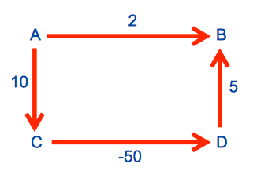
Why does not work on negative edges?

Slide 13
VlogV + ElogV

Slide 14
Modified Dijkstra’s

Slide 15
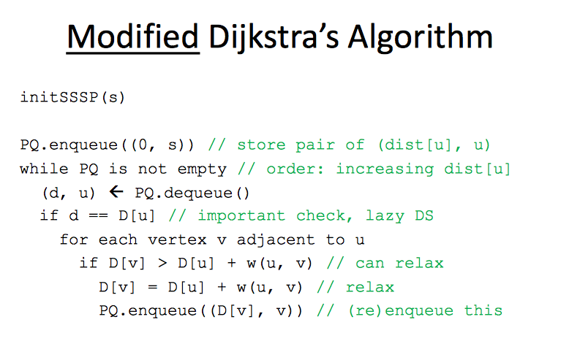

Slide 17
on to the tutorial

Slide 18
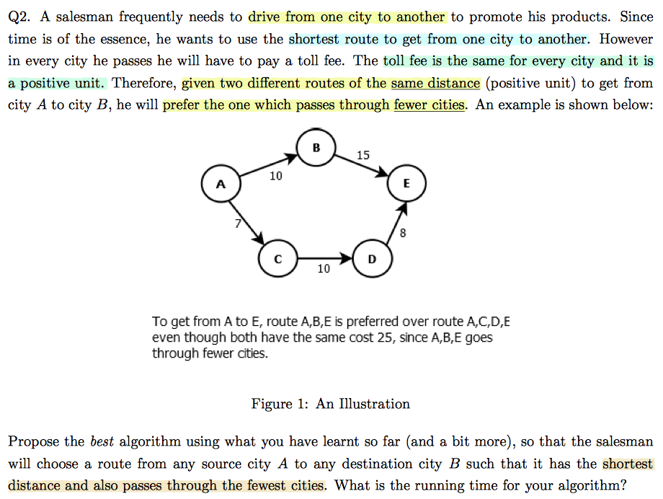

Slide 19
store triplets (d[v], h[v], v)

Slide 20



Slide 21
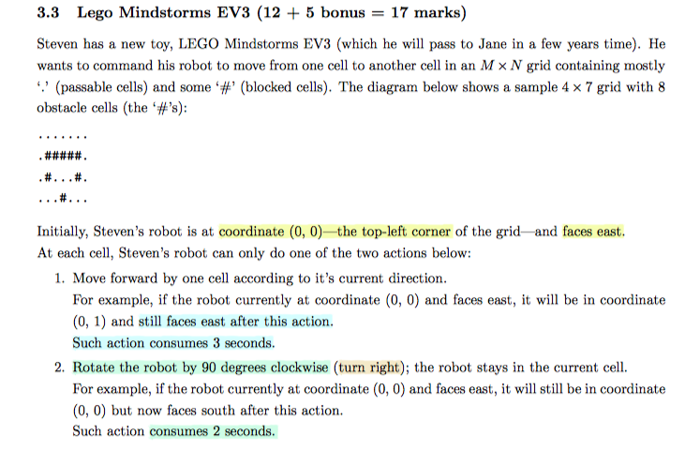

Slide 22
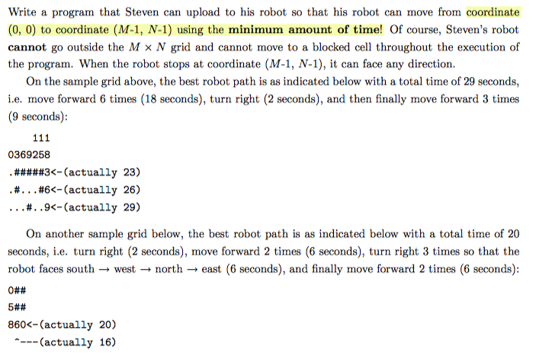

Slide 23
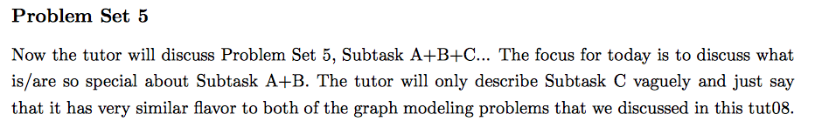

Slide 24
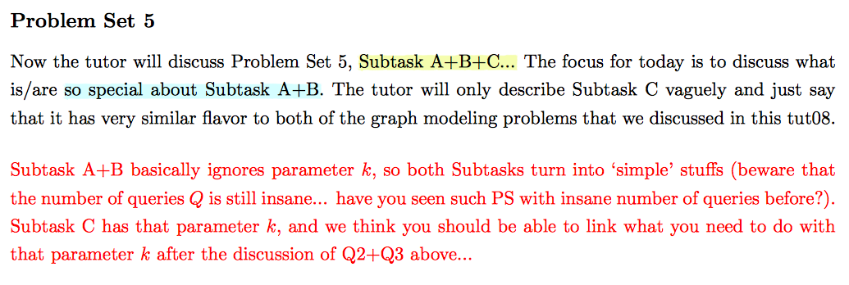

Slide 25
BYE

